Slide 1
Build Heap
Let index = length/2-1. This is the parent of the last node in the tree, i.e. list[index + 1] . . . list[length-1] are leaves
Convert the subtree with root of list[index] into a heap.
    Given list[a] is root of tree, list[b] is left child (root *2 +1), list[c] is right child (root*2+2), if exists
    Compare list[b] with list[c] to determine larger child, list[largerIndex]
    Compare list[a] with list[largerIndex]. If list[a] < list[largerIndex], then swap, else already a heap
    If swap, repeat step 2 for the subtree of list[largerIndex]
Convert the subtree with the root of list[index-1] into a heap, repeat until list[0]
Heap Sort
Swap the root with the end of the list.
Heapify the list up to but not including the root
Repeat until there is only one node in the list

Slide 2
Simulate the heapsort algorithm manually to sort the array:
Show all steps
Make into a heap
Sort
Max-Heap
[ 0 ]
[ 1 ]
[ 2 ]
[ 3 ]
[ 4 ]
[ 5 ]
[ 6 ]
[ 7 ]
[ 8 ]
[ 9 ]
5
22
9
76
63
81
48
92
54
28

Slide 3
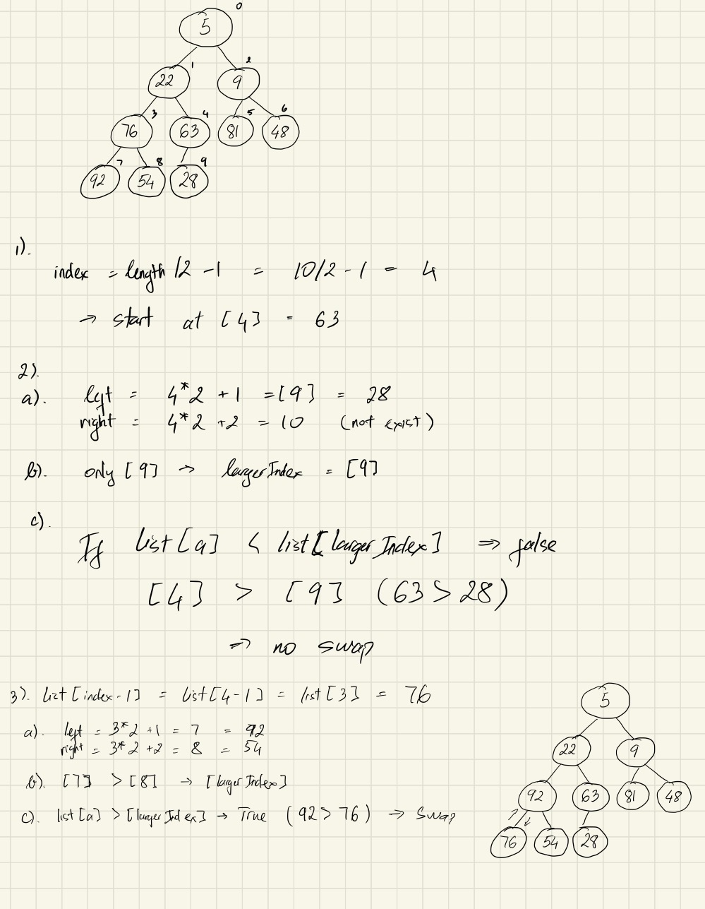
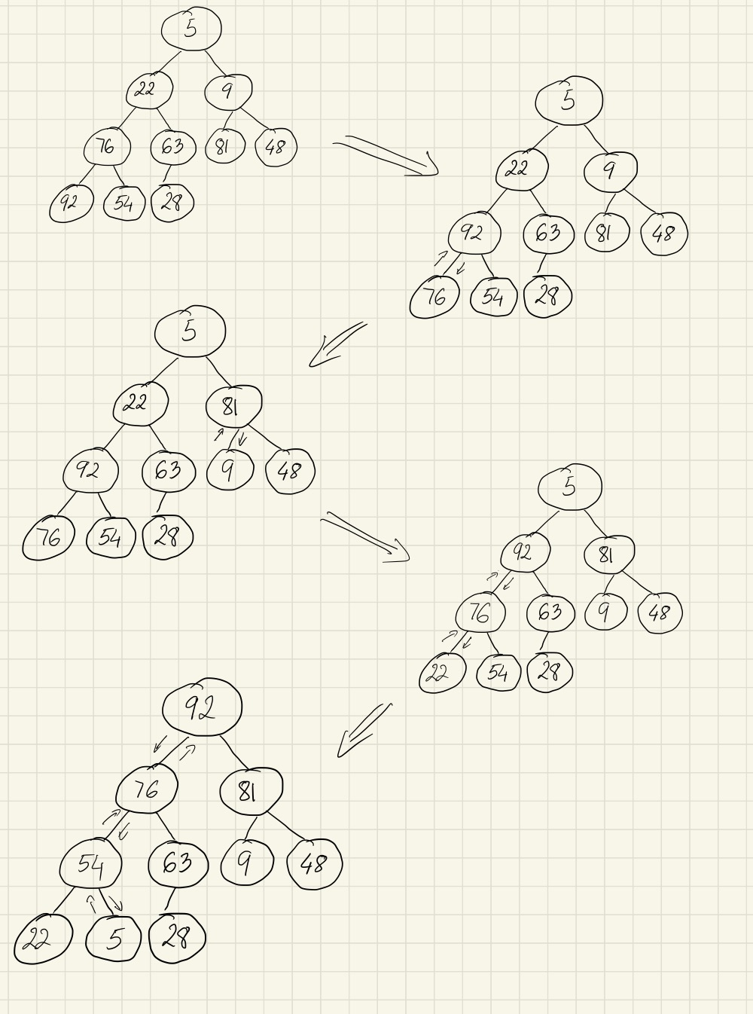

Slide 4
[ 0 ]
[ 1 ]
[ 2 ]
[ 3 ]
[ 4 ]
[ 5 ]
[ 6 ]
[ 7 ]
[ 8 ]
[ 9 ]

Slide 5
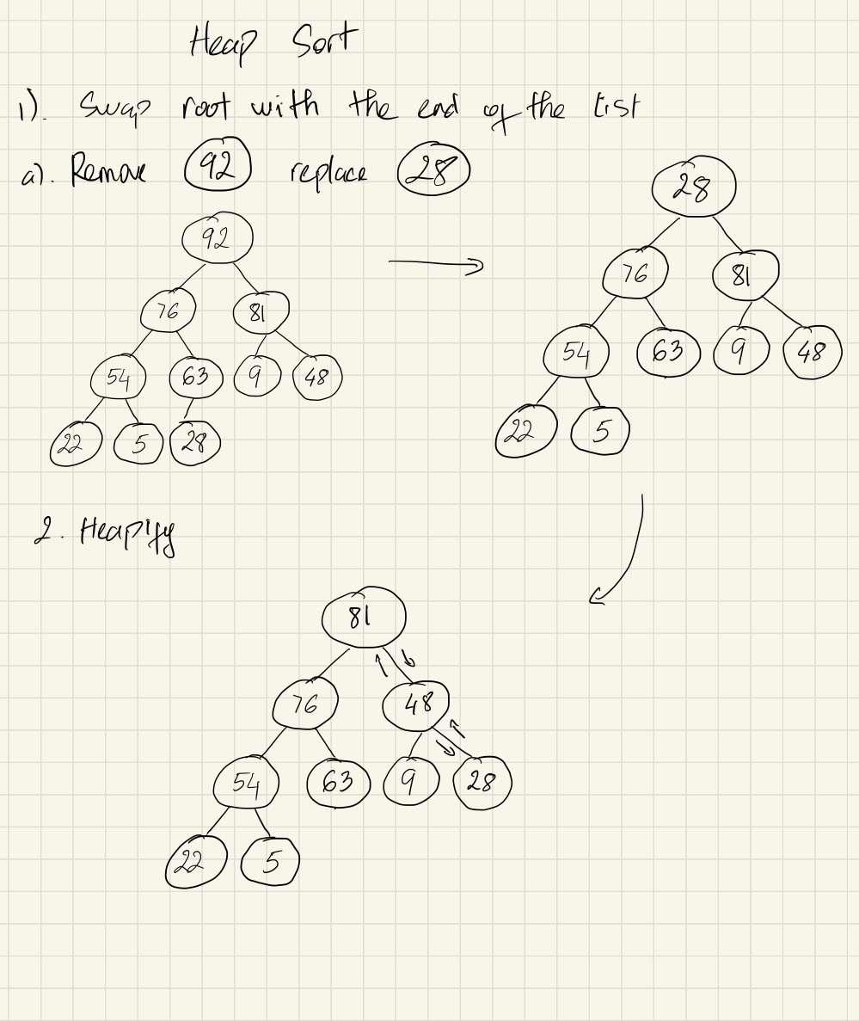
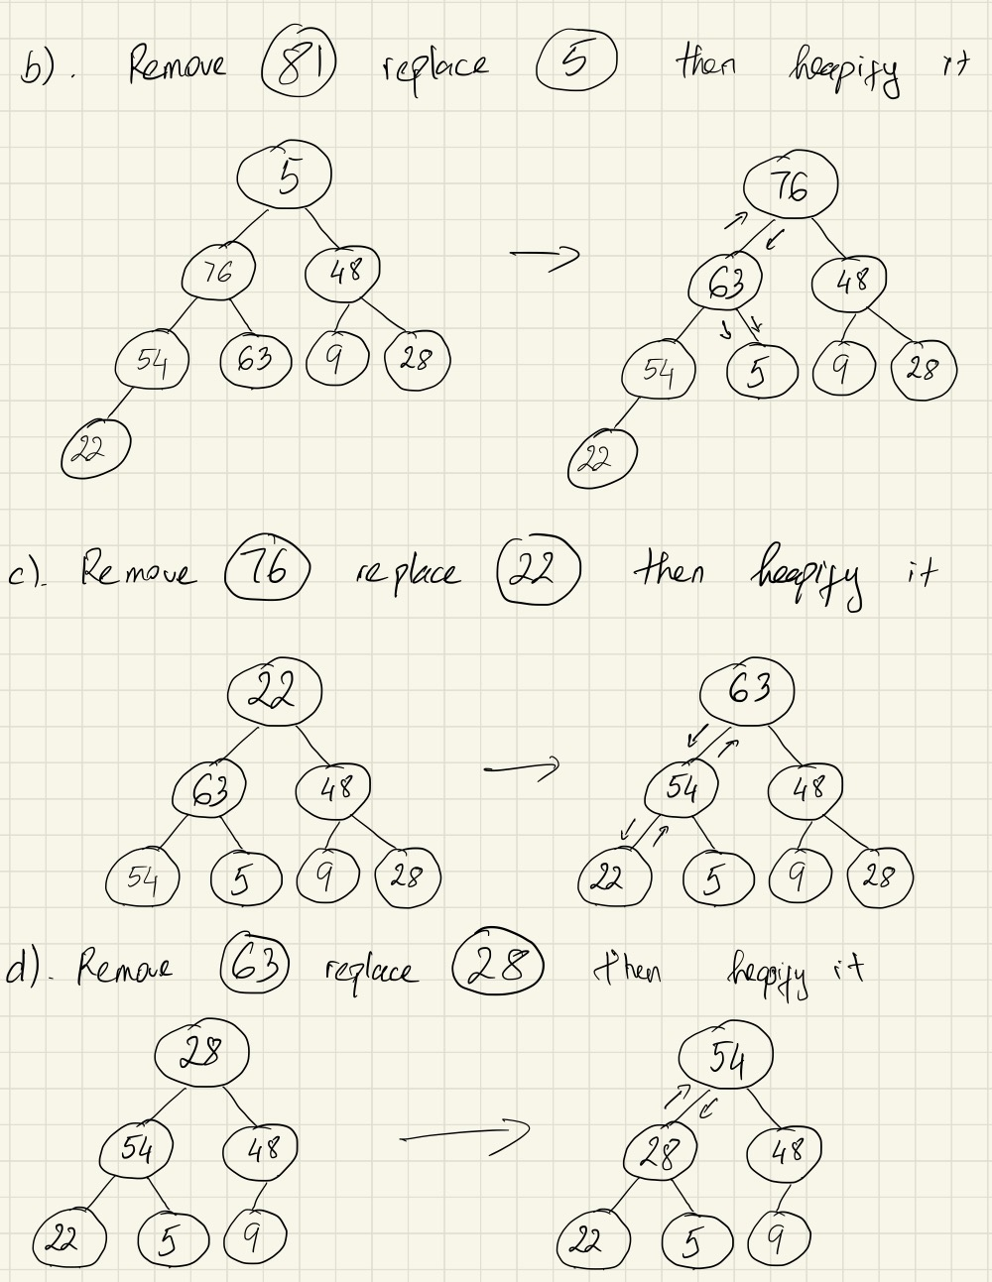
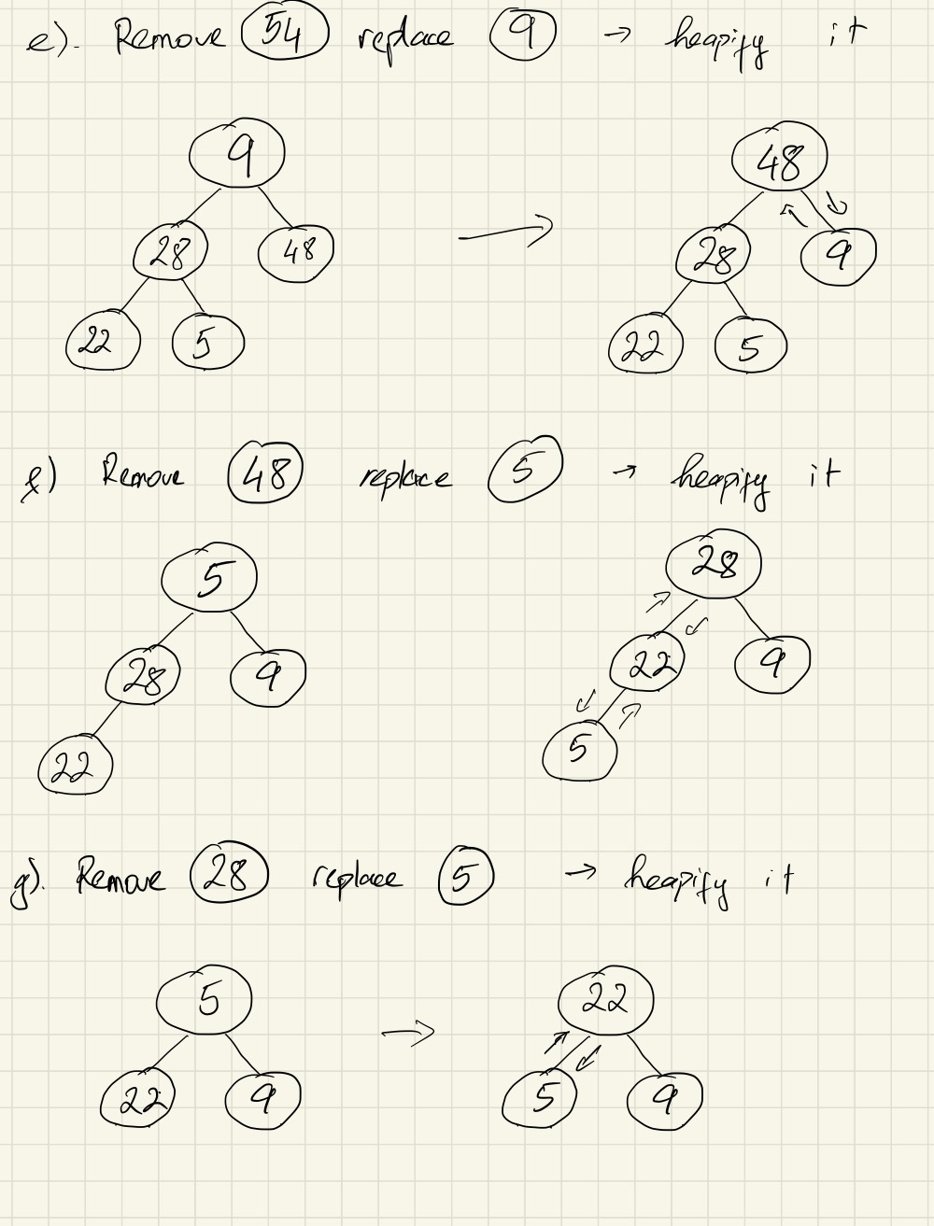
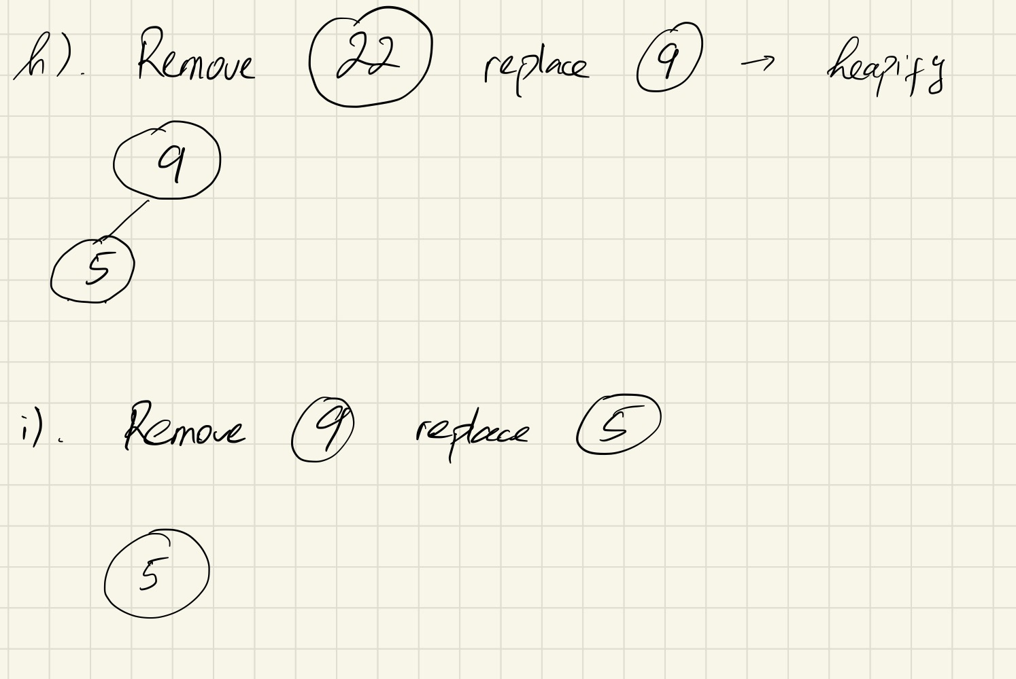

Slide 6
[ 0 ]
[ 1 ]
[ 2 ]
[ 3 ]
[ 4 ]
[ 5 ]
[ 6 ]
[ 7 ]
[ 8 ]
[ 9 ]

